Slide 1

Airplane - Boeing 777

Slide 2
The characteristics
Reactive systems: Near-Earth Warning Systems (GPWS)
Real-time systems: Global Positioning System (GPS)
Continuous/discrete/hybrid systems: Continuous Climb and Descent Operations (CCOs and CDOs)
Dependable systems:
sealed modular component of an airplane
designed to be replaced quickly at an operation location for cost reduction
designed to a common specification
Distributed systems: Integrated avionics system

Slide 3
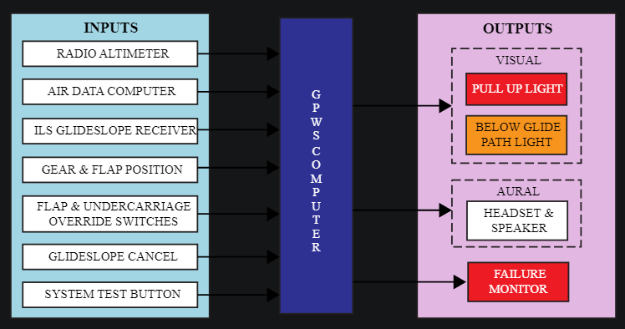
The architecture
Reactive Systems → GPWS
GPWS relied on the airplane’s radio altimeter, which determines the aircraft’s altitude by bouncing a radar signal off the ground and measuring the duration of the signal’s round trip.

Slide 4
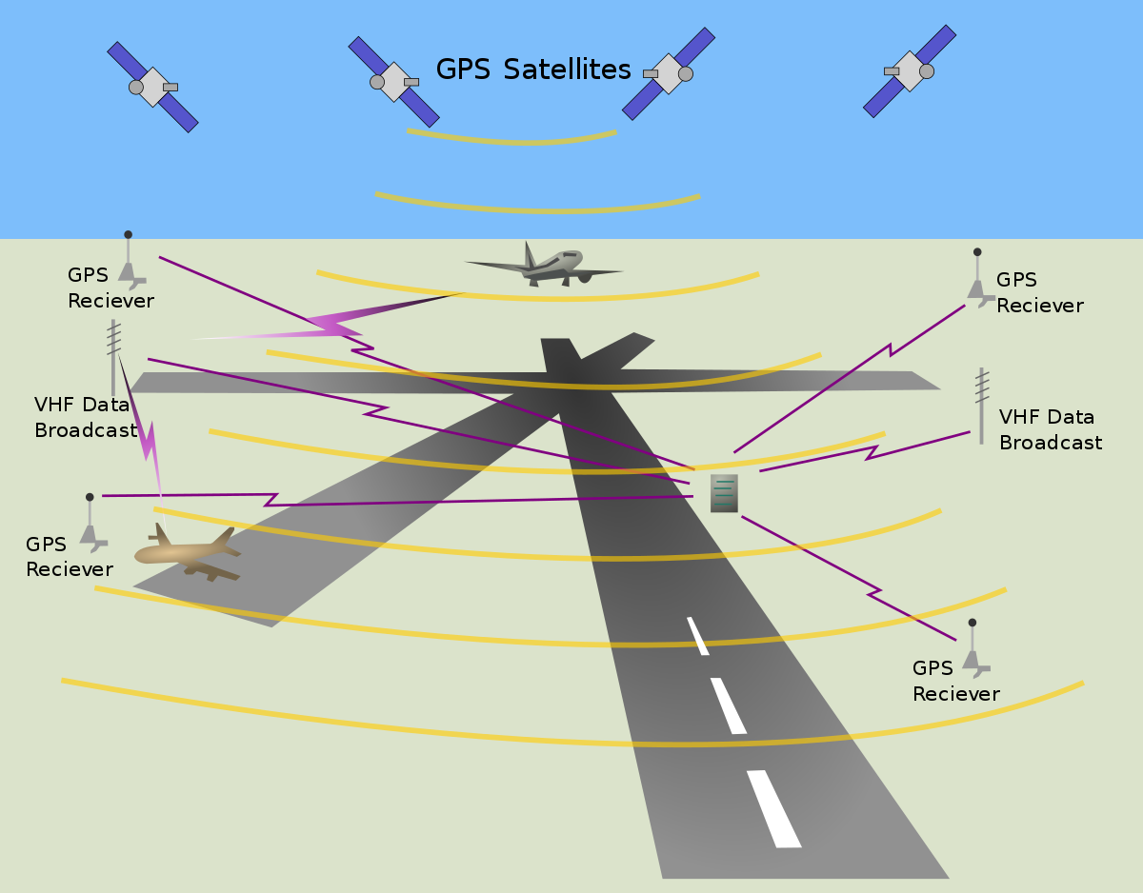
The architecture
Real-time systems → GPS
GPS satellites carry atomic clocks that provide extremely accurate time. The time information is placed in the codes broadcast by the satellite so that a receiver can continuously determine the time the signal was broadcast.

Slide 5
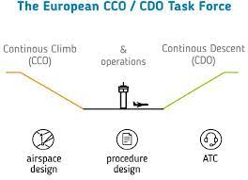
The architecture
Continuous systems → CCOs and CDOs
Aircraft applying CCO employ optimum climb engine thrust and climb speeds until reaching their cruising levels. With CDO, aircraft employ minimum engine thrust, ideally from top of descent and in a low drag configuration, prior to the final approach fix. Employment of these techniques reduces intermediate level-offs and results in time being spent at more fuel-efficient higher cruising levels, hence significantly reducing fuel burn and lowering emissions and fuel costs

Slide 6
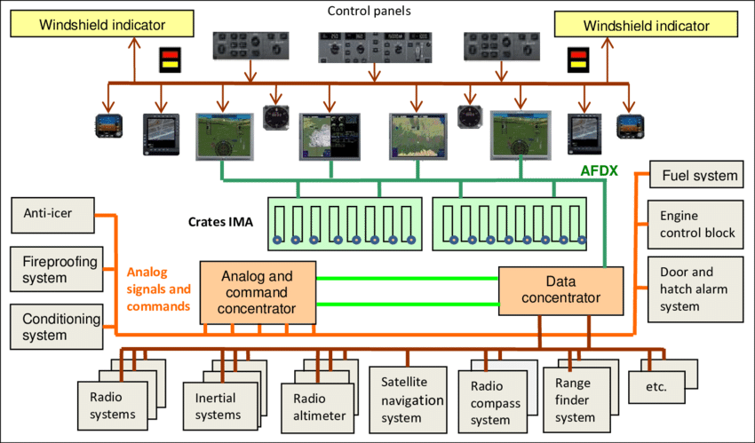
The architecture
Distributed systems -> Integrated avionics system
due to the use of distributed computer structure, standard aircraft internal data bus, fault tolerance technology and other more advanced technology, aviation integrated system flexible, adaptable and highly reliable, this system has gradually been used in some advanced fighter aircraft and high-performance civil aircraft.

